Slide 1

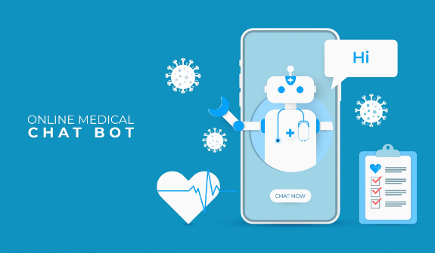
Medical Chatbot
Our Medical Chatbot project utilizes cutting-edge AI models like Gemini 1.5 to deliver highly personalized and reliable healthcare interactions. Powered by state-of-the-art natural language processing and machine learning algorithms, our chatbot aims to revolutionize the way patients interact with healthcare systems.
Team:
Mazharuddin Mohammed
Ashur Raju Addanki
Jayanth Vodnala

Slide 2

Assumptions and Timeline
Data Collection and Preprocessing
1
We collected a dataset of 16,000 rows of data from Hugging Face.
2
Training Roberta Model
We trained the Roberta model, a transformer-based model, to use it in our chatbot.
Training Gemini Pro 1.5 Model
3
We trained the Gemini Pro 1.5 model on the same dataset and achieved marvelous results.
4
Integration with Chatbot
We integrated our trained models with our created chatbot using Streamlit.

Slide 3

Enhancing Chatbot Intelligence
1
Conditional Inputs
The initial version of the chatbot focused on understanding user inputs and providing predefined responses based on conditions. This foundational stage laid the groundwork advancements, establishing the logic and response mechanisms essential for the chatbot's functionality.
2
Contextual Training
A pivotal transition occurred with the decision to train the Gemini Pro 1.5 model on a contextual dataset extracted from PDF sources. This strategic shift marked a significant enhancement in the chatbot's intelligence and responsiveness, enabling it to generate more accurate and contextually relevant responses.
3
Expanding Knowledge
The scope of the project expanded to incorporate a broader knowledge base by integrating multiple PDF sources. This integration of diverse medical information empowered the chatbot to address a wider spectrum of user queries with greater accuracy and relevance.

Slide 4
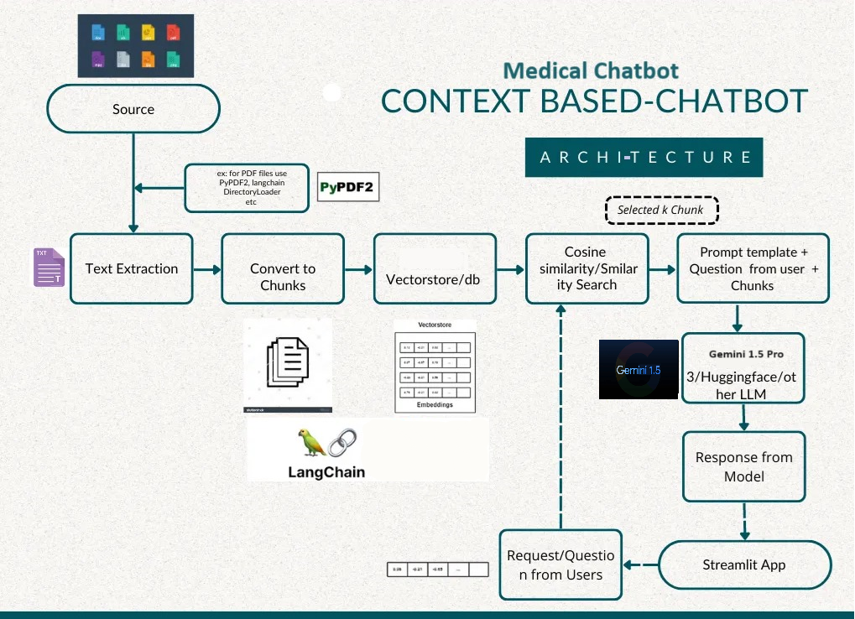
Enhanced Architecture of Our Medical Chatbot
Our medical chatbot's enhanced architecture is designed to not just respond, but to understand and contextualize user inquiries. The process begins with diverse medical texts, followed by text extraction, chunk conversion, and vectorization. Advanced similarity search methods connect user queries with relevant information, and the core model integrates powerful AI models for precise and informed responses. Users interact with the chatbot through a user-friendly interface, ensuring a smooth and engaging experience. This architecture represents a significant leap forward in medical AI technology, enhancing the user experience in medical inquiries.

Slide 5

Methodology
1
1. Project Overview
2
2. Enhanced Intelligence
The project aimed to revolutionize healthcare interactions with an advanced medical chatbot. Starting with a rudimentary version, the initial phase focused on understanding user inputs and providing predefined responses.
The Gemini Pro 1.5 model was trained on a contextual dataset extracted from PDF sources, enabling the chatbot to generate more accurate and contextually relevant responses.
3
3. Expanded Knowledge Base
4
4. Advanced AI Models
The RoBERTa model was integrated to enhance the chatbot's response quality and natural language processing capabilities.
Multiples PDF sources were integrated to enrich the chatbot's understanding and response capabilities across a diverse range of medical topics.

Slide 6
Integrating Advanced AI Models
Transformers (RoBERTa)
Large Language Models (LLMs)
Comparative Analysis
The comparative analysis of different AI models, including transformers and LLMs, played a crucial role in evaluating their performance and efficacy. This analysis guided the decision-making process towards adopting Gemini 1.5 as the preferred choice, balancing accuracy, naturalness, and computational feasibility for the healthcare chatbot's requirements.
The project integrated transformers of the seq-2-seq type, specifically the RoBERTa model, to enhance the chatbot's response quality and natural language processing capabilities. RoBERTa's advanced language understanding capabilities enabled the chatbot to interpret user queries more effectively, leading to more accurate and contextually relevant.
The team incorporated Large Language Models (LLMs), with the Gemini 1.5 LLM being the ultimate choice. Gemini 1.5 brought a new dimension to the chatbot's capabilities, leveraging its vast language understanding and generation capabilities to handle the intricacies of medical terminology, context, and diverse user queries.

Slide 7

Achieving Robust Performance
1
Accuracy
2
Response Quality
3
Computational Efficiency
The chatbot achieved a commendable accuracy rate of 93% with the Gemini 1.5 Large Language Model (LLM) during training and validation phases, reflecting the model's robustness in understanding complex medical queries and generating accurate responses.
The quality of responses significantly improved with Gemini 1.5, as noted by users and through systematic evaluations. Responses were not only accurate but also contextually relevant, engaging, and natural-sounding, enhancing the overall user experience.
Despite the increased complexity of LLMs, Gemini 1.5 demonstrated efficient computational performance, striking a balance between accuracy and resource utilization. Training times were reasonable, and inference speed met real-time interaction requirements, ensuring smooth chatbot functionality.

Slide 8


Improvements Made
In the initial phase, our project integrated seq-2-seq transformers, specifically the RoBERTa model, to enhance the chatbot's response quality and natural language processing capabilities. RoBERTa's advanced language understanding enabled the chatbot to interpret user queries effectively, resulting in accurate and contextually relevant responses.
After further enhancements, we incorporated Large Language Models (LLMs) to take the chatbot's capabilities to the next level. Among the different LLMs available in the market, we chose the Gemini 1.5 LLM for its superior language understanding and generation abilities. Gemini 1.5 revolutionized the chatbot's capabilities by enabling it to handle medical terminology, diverse user queries, and contextual nuances with ease.

Slide 9


Results and Analysis
The Results and Analysis section details the performance metrics, user feedback, and insights gained from deploying advanced AI models like Gemini 1.5 in our healthcare chatbot system.
Performance Metrics:
Accuracy: Our chatbot achieved a commendable accuracy rate of 93% with the Gemini 1.5 Large Language Model (LLM) during training and validation phases.
Response Quality: The quality of responses significantly improved with Gemini 1.5, as noted by users and through systematic evaluations.
Computational Efficiency: Despite the increased complexity of LLMs, Gemini 1.5 demonstrated efficient computational performance, striking a balance between accuracy and resource utilization.

Slide 10




Contributions and Future Implications
Enhanced Response Quality
The integration of Gemini 1.5 has significantly improved response quality, accuracy, and coherence in the chatbot's interactions, contributing to better user satisfaction and trust in the chatbot's capabilities.
Scalability and Adaptability
Gemini 1.5's scalability and adaptability have allowed the chatbot to handle diverse queries, integrate new knowledge sources seamlessly, and evolve with changing user needs and technological advancements.
Innovation in Healthcare AI
The project contributes to the ongoing innovation in healthcare AI, paving the way for more sophisticated and effective conversational systems tailored to medical contexts, with implications for improving healthcare access, information dissemination, and patient engagement.

Slide 11

Conclusion and Future Directions
1
Continued Improvement
2
Integration with Healthcare Systems
3
Ethical Considerations
Our team plans to continue refining the chatbot by incorporating more data sources, fine-tuning response generation algorithms, and enhancing the chatbot's conversational capabilities. This continuous improvement cycle ensures that the chatbot remains up-to-date and responsive to evolving user requirements.
The success of the chatbot opens avenues for integration with healthcare systems, patient portals, and telemedicine platforms. This integration can streamline patient interactions, provide instant medical information, and support healthcare professionals in their decision-making processes.
As AI-driven healthcare solutions proliferate, the team remains committed to ethical considerations such as data privacy, transparency in AI decision-making, and maintaining user trust. These considerations are crucial for ensuring responsible AI deployment in healthcare settings.

Slide 12
Thank you!

